Slide 1
Assignment 3
Social Engineering

Slide 2
What is social engineering
Social engineering attacks happen in one or more steps. A perpetrator first investigates the intended victim to gather necessary background information, such as potential points of entry and weak security protocols, needed to proceed with the attack. Then, the attacker moves to gain the victim’s trust and provide stimuli for subsequent actions that break security practices, such as revealing sensitive information or granting access to critical resources.

Slide 3
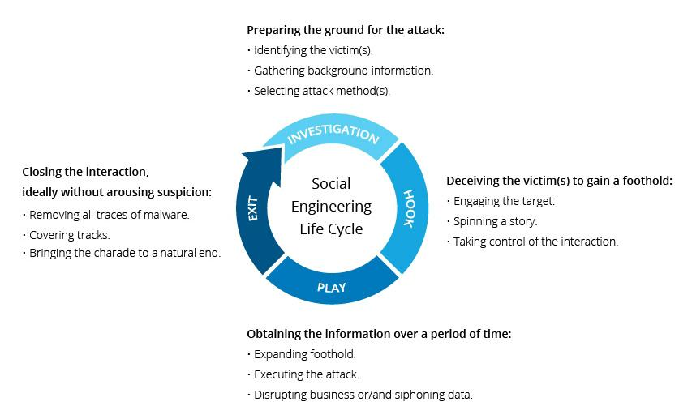
Social engineering lifecycle attack

Slide 4
Social engineering attack techniques
Baiting As its name implies, baiting attacks use a false promise to pique a victim’s greed or curiosity. They lure users into a trap that steals their personal information or inflicts their systems with malware
Scareware Scareware involves victims being bombarded with false alarms and fictitious threats. Users are deceived to think their system is infected with malware, prompting them to install software that has no real benefit (other than for the perpetrator) or is malware itself. Scareware is also referred to as deception software, rogue scanner software and fraudware..

Slide 5
Pretexting Here an attacker obtains information through a series of cleverly crafted lies. The scam is often initiated by a perpetrator pretending to need sensitive information from a victim so as to perform a critical task.
Phishing As one of the most popular social engineering attack types, phishing scams are email and text message campaigns aimed at creating a sense of urgency, curiosity or fear in victims. It then prods them into revealing sensitive information, clicking on links to malicious websites, or opening attachments that contain malware.

Slide 6
Social engineering prevention
Don’t open emails and attachments from suspicious sources – If you don’t know the sender in question, you don’t need to answer an email. Even if you do know them and are suspicious about their message, cross-check and confirm the news from other sources, such as via telephone or directly from a service provider’s site. Remember that email addresses are spoofed all of the time; even an email purportedly coming from a trusted source may have actually been initiated by an attacker.

Slide 7
Use multifactor authentication – One of the most valuable pieces of information attackers seek are user credentials. Using multifactor authentication helps ensure your account’s protection in the event of system compromise. Imperva Login Protect is an easy-to-deploy 2FA solution that can increase account security for your applications. Be wary of tempting offers – If an offer sounds too enticing, think twice before accepting it as fact. Googling the topic can help you quickly determine whether you’re dealing with a legitimate offer or a trap. Keep your antivirus/antimalware software updated – Make sure automatic updates are engaged, or make it a habit to download the latest signatures first thing each day. Periodically check to make sure that the updates have been applied, and scan your system for possible infections.

Slide 8
Examples of social engineering attacks
Perhaps the most famous example of a social engineering attack comes from the legendary Trojan War in which the Greeks were able to sneak into the city of Troy and win the war by hiding inside a giant wooden horse that was presented to the Trojan army as a symbol of peace. In more modern times, Frank Abagnale is considered one of the foremost experts in social engineering techniques. In the 1960s, he used various tactics to impersonate at least eight people, including an airline pilot, a doctor and a lawyer. Abagnale was also a check forger during this time. After his incarceration, he became a security consultant for the Federal Bureau of Investigation and started his own financial fraud consultancy. His experiences as a young con man were made famous in his best-selling book Catch Me If You Can and the movie adaptation from Oscar-winning director Steven Spielberg.

